Slide 1
CS3081: “Artificial Intelligence”
Functional Programing
Prof Passent Elkafrawy
pelkafrawy@effatuniversity.edu.sa
CoE112, ext 7896

Slide 2
Reading R&N
The slides were inspired from:
Introduction to Functional Programming Concepts and the Scheme language.
UT-Arlington ©Chengkai Li,

Slide 3
Introduction
In Theory of Computing, a program is viewed as a function. A program maps each input to some output:
P: Input → Output
deterministic program: the input completely determines the output:
output = P(input)
Functional programs puts this model into practice: programs are written in terms of a sequence of functions, typically with nested evaluation:
P(input) = (F(g(h(input))) U ... )
Evaluating the program produces the output.

Slide 4
Functional Programming
Functional programming is a style of programming:
Imperative Programming:
Program = Data + Algorithms
OO Programming:
Program = Object. message (object)
Functional Programming:
Program = Functions (Applications)
Logic (or Declarative)
Computation is done by application of functions

Slide 5
Characteristics of Functional Lang.
based on functions as mappings (as in mathematics)
f: Domain → Range
functions are referentially transparent:
the mapping does not depend on any "state"
value returned depends only on the parameters
functions do not have side effects
"variables" represent values, not memory locations.
in a pure functional language, assignment is not allowed
repetition is done by recursion instead of iteration
can't write "for" or "while" loops without variables
automatic memory management

Slide 6
History
Lambda Calculus (Church, 1932-33) | formal model of computation
Lisp (McCarthy, 1960) Scheme, 70s | symbolic computations with lists
APL (Iverson, 1962) | algebraic programming with arrays
ISWIM (Landin, 1966) | let and where clauses equational reasoning; birth of “pure” functional programming ...
ML (Edinburgh, 1979) Caml 1985, Ocaml | originally meta language for theorem proving
SASL, KRC, Miranda (Turner, 1976-85) | lazy evaluation
Haskell (Hudak, Wadler, et al., 1988) | “Grand Unification” of functional languages ...

Slide 7

Functional Programming Concepts
Scheme is a particularly elegant Lisp
Other functional languages
ML
Miranda
Haskell
FP
Haskell is the leading language for research in functional programming

Slide 8
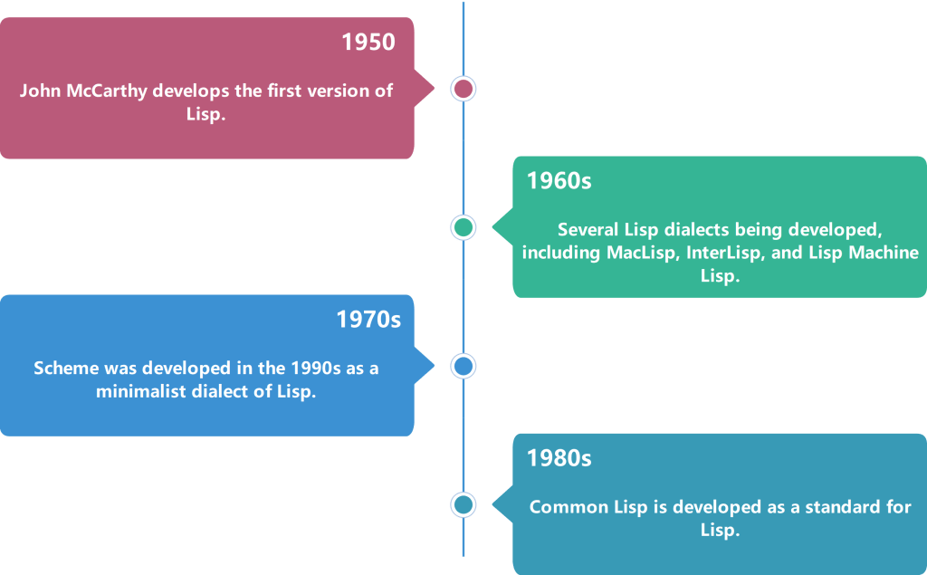
The Development of Lisp

Slide 9
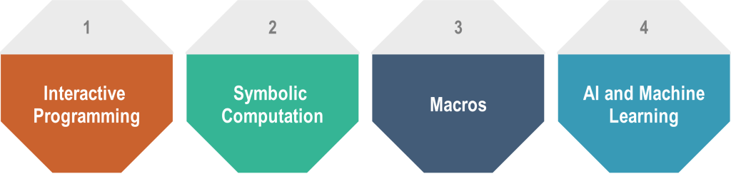
Why Lisp is Still Used Today
Interactive programming: Lisp allows programmers to modify and test code interactively, making debugging and developing programs easier.
Symbolic computation: Lisp has powerful capabilities for manipulating symbolic data structures, such as lists and trees.
Macros: Lisp allows programmers to define their own syntax and language constructs using macros, which can lead to more concise and expressive code.
AI and machine learning: Lisp has historically been used in artificial intelligence and machine learning research and is still used in some research areas.

Slide 10
Functions get some respect!
functions are first class entities in functional languages
a first class entity in a programming language is something that can be:
passed as argument to a subprogram
returned as result from a subprogram
used as an operand or r-value
; Scheme example: apply function to all values in a list
(define apply-to-all ( fun values )
(if (null? values) '()
(cons (fun (car values) )
(apply-to-all fun (cdr values) ) ) ; recursion
)
)

Slide 11
Scheme – first introduction
Scheme is a popular Lisp dialect.
Lisp and Scheme adopt a form of prefix notation called Cambridge Polish notation.
Scheme is case-insensitive.
A Scheme expression is composed of
Atoms, e.g. a literal number, string, or identifier name.
Lists, e.g. '(1 2 3)
Function invocations written in list notation: the first list element is the function (or operator) followed by the arguments to which it is applied: (function a1 a2 a3 ... an)
For example, sin(x*x+1) is written as (sin (+ (* x x) 1))

Slide 12
Example
Square the integers in an array in Java:
int square[] = {1,3,6,8};
for (i = 1; i ≤ 4; ++i)
square[i] = square[i]* square[i];
The computation method is variable assignment.
12

Slide 13
Example
Square the integers in an array in Lisp:
(defun square (x)
(* x x))
(square 2)
;; Returns 4
(square 3)
;; Returns 9
The computation method is lambda accumulation.
13

Slide 14
Functions in Scheme
we can use apply-to-all to evaluate any function
arguments don't have to be numbers
; even? is a builtin function that returns TRUE for even
> (apply-to-all even? '(3 8 12 5 22) )
(#f #t #t #f #t)
; define our own square function, then use it
(define (square x) (* x x) )
> > (apply-to-all square '(2 5 8 100 12345678) )
(4 25 64 10000 152415765279684)

Slide 15
Applications
Artificial intelligence
Expert systems
these areas make use of ability to dynamically define functions.
Program can "learn" by creating new functions
Theory of computing
simulate functional nature of computation
Prototyping
programs have no side-effects, so easy to isolate errors and built modular programs

Slide 16
Why does it matter, anyway?
The advantages of functional programming languages:
Simple semantics, concise, flexible
``No’’ side effect
Less bugs
It does have drawbacks:
Execution efficiency
More abstract and mathematical, thus more difficult to learn and use.
Even if we don’t use FP languages:
Features of recursion and higher-order functions have gotten into most programming languages.

Slide 17
Pure Functional Programming
Variables represent values, not memory locations,
OK: define pi = 3.14159
Illegal: x = x + 1;
No loops (why?)
No state

Slide 18
Referentially Transparent
the value of a function depends only on the value of its parameters.
No state
Question: Which of these functions are referentially transparent?
C: int c = getchar();
Java: int c = System.in.read();
Java: double y = Math.sqrt(7.5);
Java: double r = Math.random( );

Slide 19
Notes and Examples
Any referentially transparent function with no parameters must always return the same value!
not referentially transparent:
random( )
getchar( )
sorting: cannot sort an array in place (no reassignment)
must create a new constant array of sorted values.

Slide 20
Replacing Loops with Recursion
Mathematical functions use recursion for iterative def'n
Factorial(n) := n * Factorial(n - 1) for n > 0
Functional programming uses recursion instead of loops
C example:
long factorial(long n) { int k; long result = 1; for(k = 1; k <= n; k++) result = k * result; return result; }
same function using recursion:
long factorial(long n) { if (n <= 1) return 1; else return n * factorial(n-1); }
Local variables not needed!

Slide 21
Tail Recursion
Tail recursion means that the last operation in a control flow is recursion.
Tail recursion can be done efficiently by an interpreter or compiler.
old stack frame can be replaced with recursive call
unwinding of a deep stack is not necessary
LISP and Scheme require that interpreters optimize tail recursion
The factorial example is not tail recursion:
long factorial(long n) { if (n <= 1) return 1; return n * factorial(n-1); }
Must call factorial before multiplication can be done.

Slide 22
Tail Recursion (2)
To use tail recursion, perform the last multiplication recursively:
// "helper function" uses tail recursion
long tailfact(int n, long result)
{ if (n <= 1) return result;
return tailfact(n-1, result*n); }
// main factorial function
long factorial(int n)
{
return tailfail(n, 1L);
}
Tail call

Slide 23
Factorial in Scheme w/ tail recursion
(define (tailfact n result)
; syntax: (if (test-expr) expr1 expr2)
(if (<= n 1) result
(tailfact (- n 1) (* n result) )
)
)
(define (factorial n) (tailfact n 1) )
Try this: (factorial 500)

Slide 24
Lambda expressions
A lambda expression defines a nameless function:
λ(x) x*x
defines a nameless function that squares a value.
Lambda calculus says nothing about operations like *, +, sqrt( ). It's just an expression.
Lambda calculus is concerned only with functional operations such as:
reduction: (λ(x) x*x) (5) is 5*5
composition: f ≡ (λ(x) x*x)
g ≡ (λ(y) y+5)
f g(u) is (u+5)*(u+5)

Slide 25
Lambda expressions in Scheme
A lambda expression defines a nameless
(lambda (x) (* x x) )
apply this function just like any other Scheme function:
> ( (lambda (x) (* x x) ) 7)
49
The syntax of lambda expressions is
(lambda list-of-parameters expr1 expr2 … )
The Scheme interpreter tells you this is a function:
> (lambda (x) (* x x) )
#<procedure>

Slide 26
define and lambda
Use lambda and define to create named functions:
(define sqr (lambda (x) (* x x)) )
(sqr 5) ; returns 25
To reduce typing, Scheme defines a "function" form of define:
(define (sqr x) (* x x) )
(define (name args) expression [...] )
is syntactic sugar for
(define name (lambda (args) expression [...]) )

Slide 27
Lambda examples
Lambda is used to generate functions dynamically, usually as return values from other functions
This enables functions to be first class entities
(define (scale-by f) ( lambda(x) (* x f) ) )
(define inch2cm (scale-by 2.54) ) ; inches to cm
(define lb2kg (scale-by 0.4545) ) ; pound to kg
; now inch2cm and lb2kg are functions!
> (inch2cm 10)
25.4
> (lb2kg 50)
22.725

Slide 28
Lambda calculus
The lambda function comes from Lambda calculus: see textbook or search the Internet.
A parameter in a lambda expression is bound if it refers to one of the parameters of the lambda, otherwise it is free.
(lambda (x) (* x y) ) ; x is bound, y is free
Consider a lambda that defines another function
(define mult (lambda(y) (lambda(x) (* x y)) ))
; both x and y are bound.
(define g (mult 5) ) ; g(x) = (* x 5)
> (g 8)
40

Slide 29
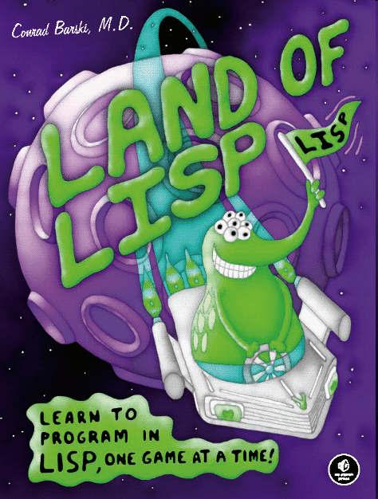
Scheme: A Lisp dialect
Simple syntax, similar to LISP.
Developed at MIT in 1970s. Used to teach programming.
Static scoping.
Functions as first-class entities.
Removes some odd behavior from Lisp.
but adds some incompatibilities...
(define a '())
> (if a (display "true") (display "false"))
In LISP, an empty list is "false".
In Scheme, any list (including empty one) is "true".

